Slide 1

CQRS and Event Sourcing with the “Critter Stack”
August 14th, 2024

Slide 2

Goals of this Workshop
Introduction to Event Sourcing
What goes into building a robust Event Driven Architecture
Convincing you all to use the “Critter Stack!”
Make you love the idea of low ceremony code

Slide 3
Environmental Requirements
Install .NET 8 SDK
Install Docker Desktop
Clone https://github.com/Jjasperfx/EventDrivenArchitectureWorkshop
From the command line, run “docker compose up –d”

Slide 4
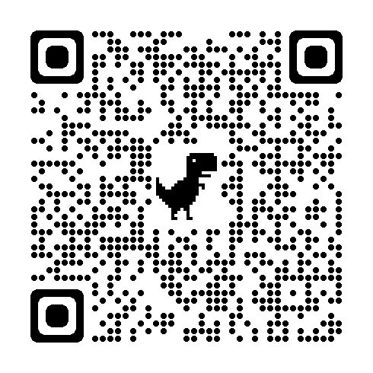


Building a Critter Stack Application Series

Slide 5
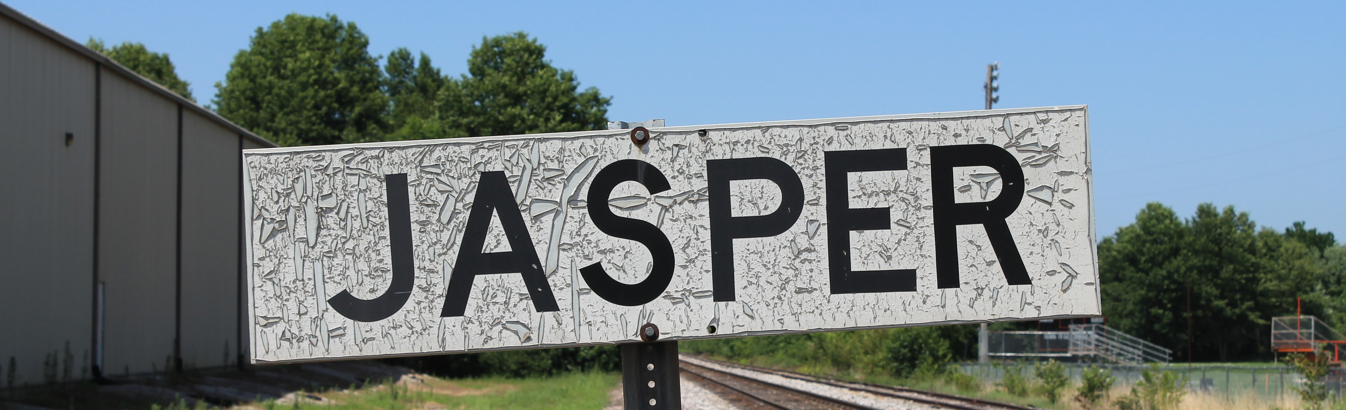
About Me
Owner and Founder of JasperFx Software LLC
Marten Core Team & Wolverine Project Leader
Longtime OSS Author (StructureMap et al)
https://jeremydmiller.com

Slide 6

The “Critter Stack”
Marten, Wolverine, Weasel (“Mustelidae”)
Toolset for Event Driven Architecture
Low ceremony coding model
High testability & low friction integration testing
Low friction developer experience
Robust system development

Slide 7
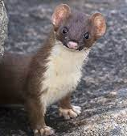
Weasel
OSS Library for Low Level Database Utilities
Supporting Actor
Command Batching
SQL Generation
Schema Migrations
Makes ADO.Net less aggravating

Slide 8
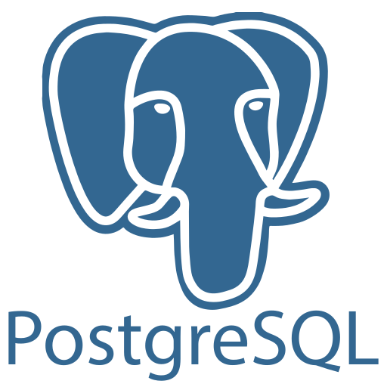
Marten
Open Source .NET Library
Uses PostgreSQL for Persistence
ACID Compliant Document Store
Integrated Event Sourcing

Slide 9
Marten as Document Database

Slide 10
Why a Document Database?
Because you can develop faster, full stop
Handles deep nested structures
Great story for polymorphic entities
Advantageous when entities are self-contained

Slide 11

Event Sourcing
A style of persistence where the single source of truth, system state is a read only, append only sequence of all the events that resulted in a change in the system state.

Slide 12
Advantages to Event Sourcing
Usage of Business Language
Audit Log
Temporal Querying / “Time Travel”
Retrofitting Metrics
Complement to CQRS
Concurrency

Slide 13
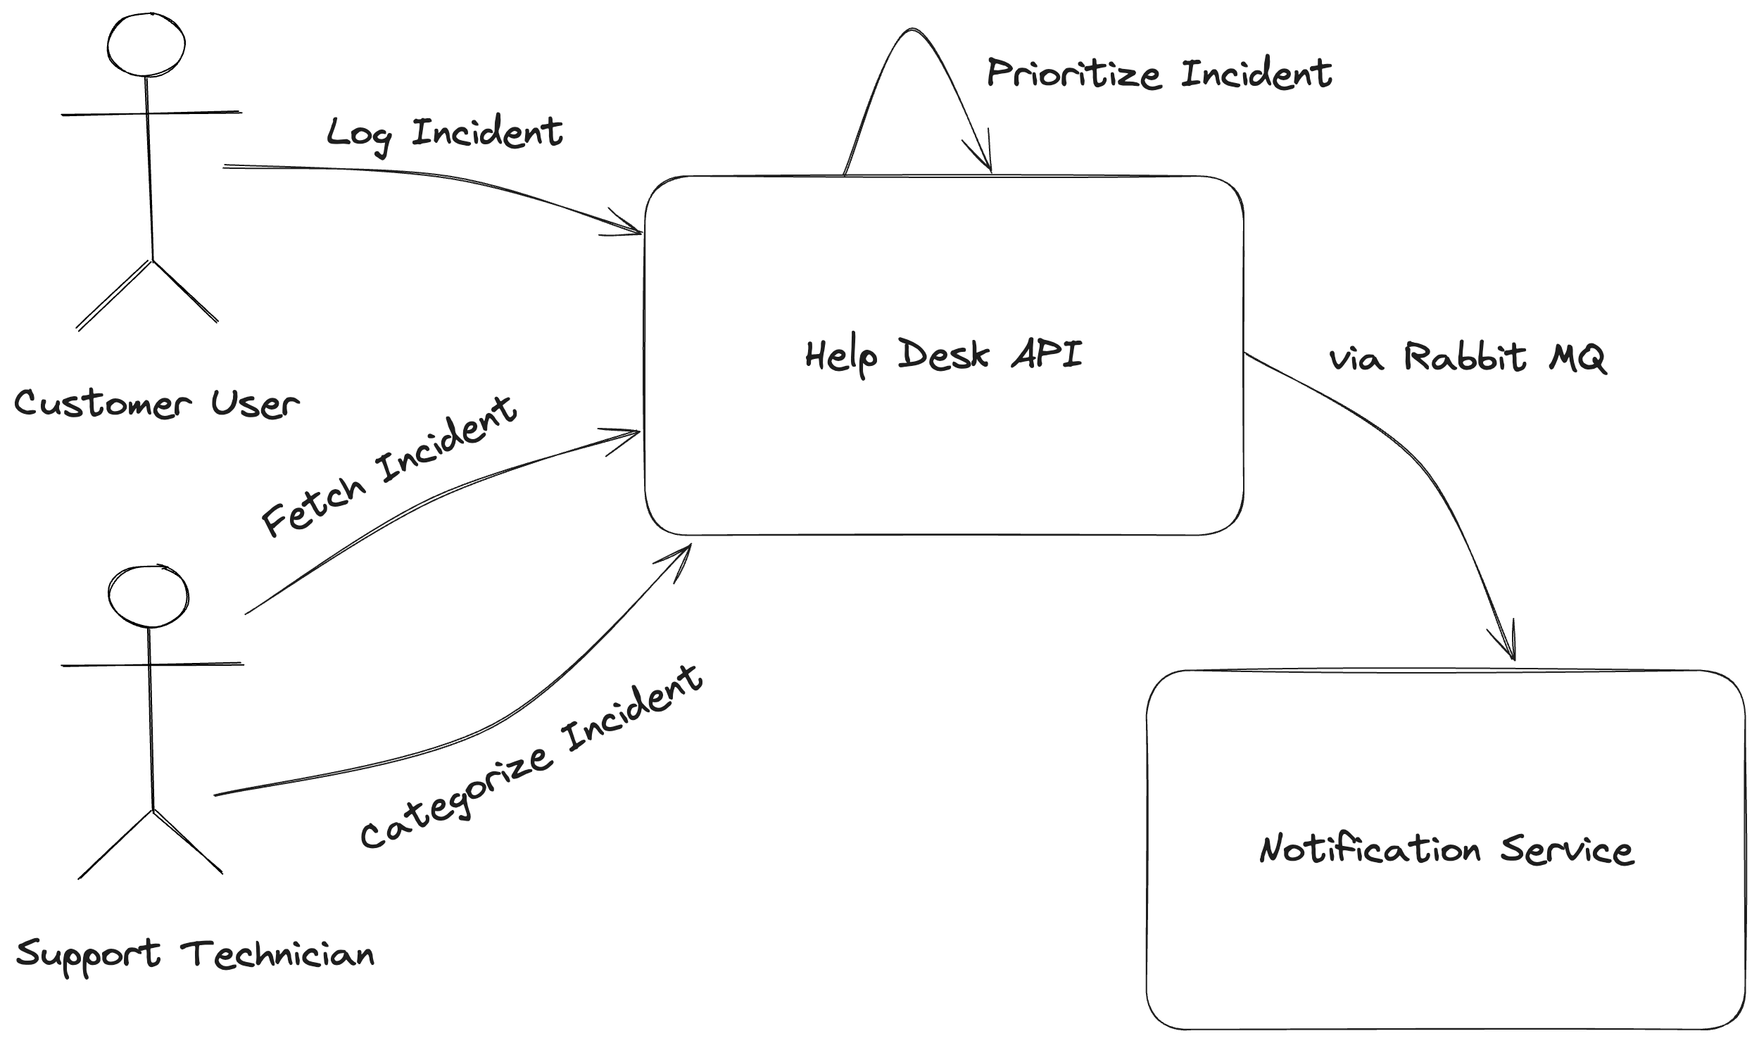
Help Desk API

Slide 14
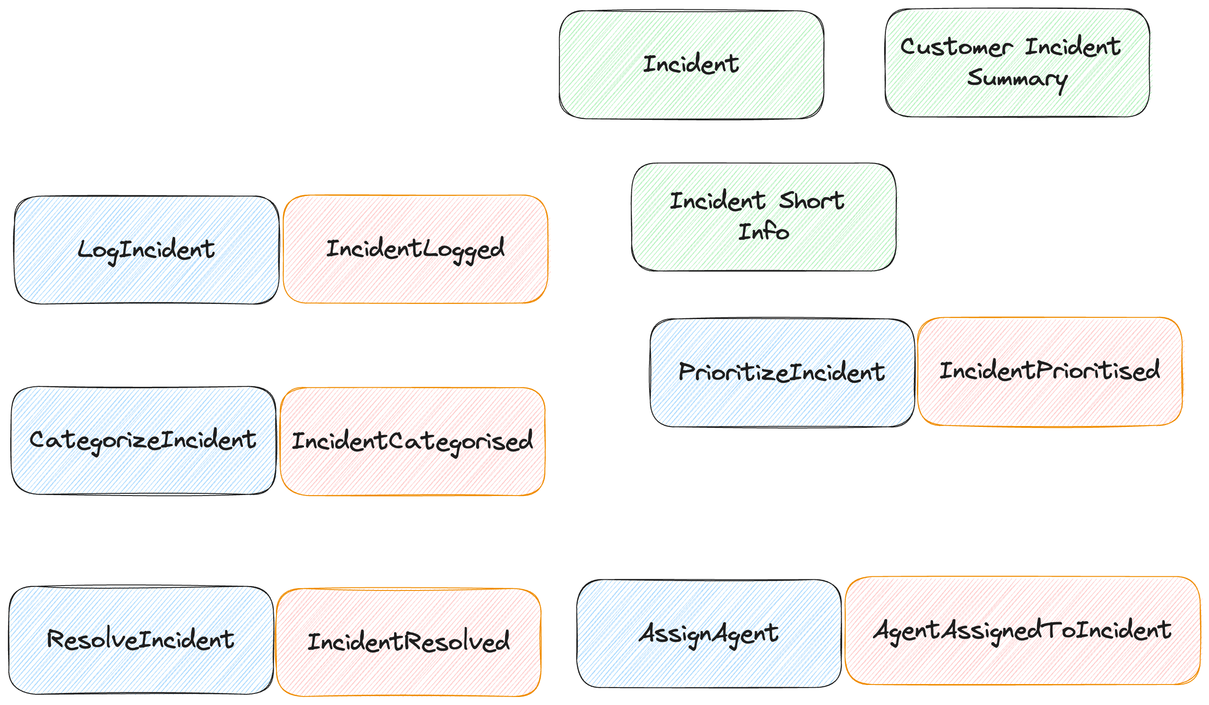
Event Storming – Help Desk Service

Slide 15

Marten Event Sourcing Quickstart

Slide 16
Marten Terminology
Event - a persisted business event representing a change in state or record of an action taken in the system
Stream - a related "stream" of events representing a single business workflow or concept
Projection - any strategy for generating a “read side” view of the system state from the events
Aggregate – in Marten terms, a flavor of projection that combines a related set of events into a single view

Slide 17
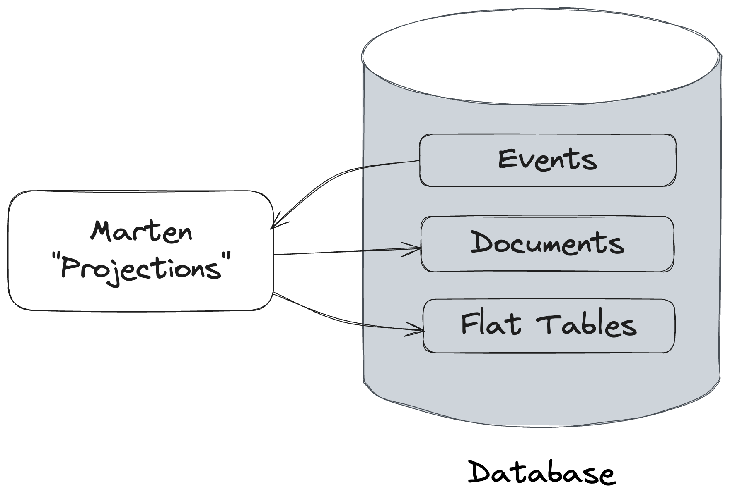
Marten Projections

Slide 18
Our first ”Incident” Projection

Slide 19
”Read Side” Web Service

Slide 20
Projection Considerations
Inline – simple approach, strong consistency, slower ”writes”, faster “reads”
Live – simple approach, strong consistency, faster “writes”, slower “reads”
Async – more complicated, eventual consistency, fast “writes”, fast “reads”

Slide 21
Time Travel

Slide 22

Fast Web Services

Slide 23
CQRS
Command Query Responsibility Segregation
A software architectural pattern where “reads” and “writes” are strictly segregated within the system

Slide 24
Building Command Handlers
Validate command inputs
Fetch existing “write” model state
Determine what new events to append
Managing transactions
Concurrency
Error handling and resiliency
Publishing events
Observability

Slide 25
Automated Integration Testing
Known inputs, expected outcomes
Marten has built in test helpers for controlling system state in tests
“Self-Contained Tests”

Slide 26
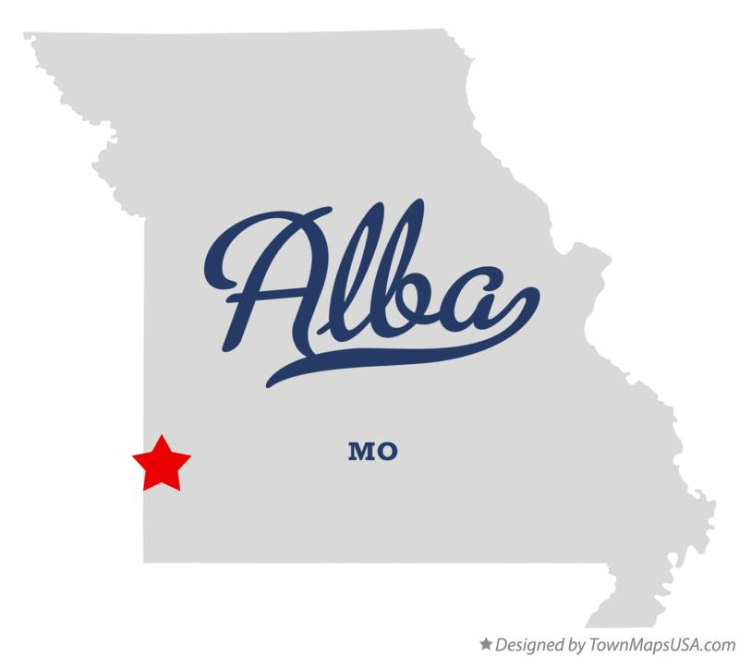
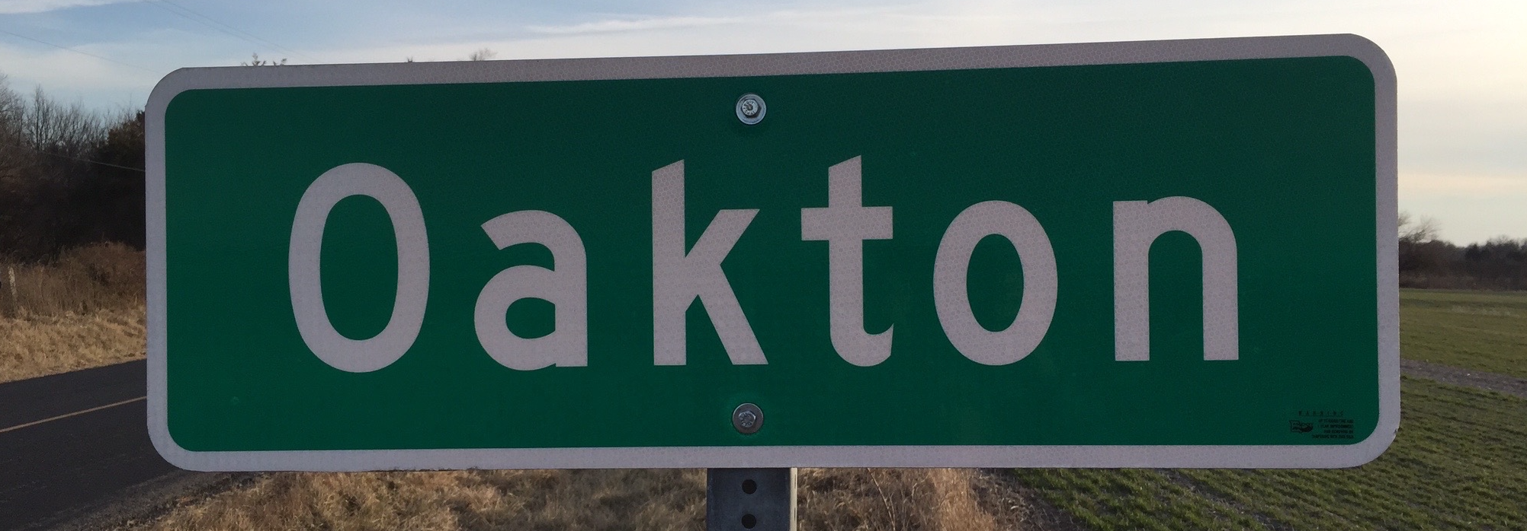
Guest starring…
Alba
Oakton
Easy Integration testing for ASP.NET Core
https://jasperfx.github.io/alba/
Parsing and Utilities for Command Line Tools in .Net
https://jasperfx.github.io/oakton

Slide 27
Building a Test Harness

Slide 28
Command Line Tools

Slide 29
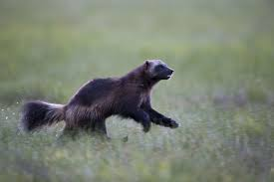
Wolverine
Open Source .NET Framework
Command Executor
Local Queueing
Asynchronous Messaging
Alternative HTTP Service Framework
Strong Integration with Marten

Slide 30
Background work with Wolverine

Slide 31
Wolverine as Mediator

Slide 32
Aggregate Handler Workflow

Slide 33

Drink the Koolaid and use Wolverine for HTTP

Slide 34
Fluent Validation Middleware

Slide 35
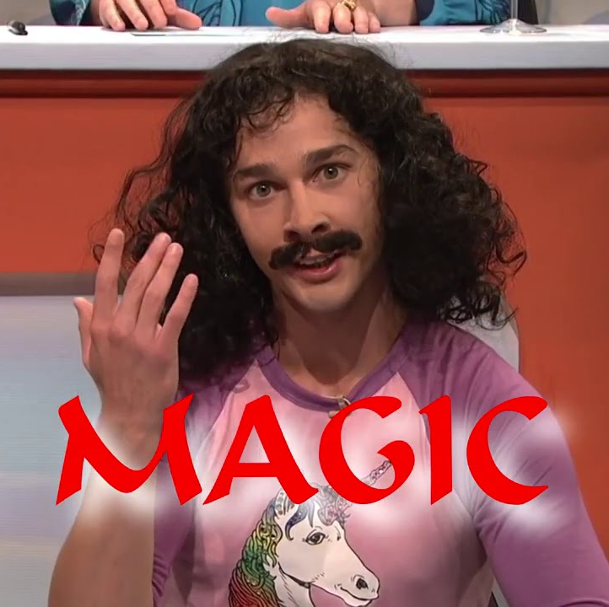
Unwinding the Magic

Slide 36
Subscribing to Events

Slide 37
Transactional Outbox

Slide 38
Integration Testing for Wolverine Message Handling

Slide 39
Vertical Slice Architecture the Wolverine Way

Slide 40
Asynchronous Messaging with Wolverine and Rabbit MQ

Slide 41
The “Stateful Resource” Model

Slide 42
Error Handling and Resiliency

Slide 43
Retries

Slide 44
Dead Letter Queues

Slide 45
Message Timeouts

Slide 46
Circuit Breakers

Slide 47
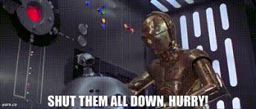
Critical Errors

Slide 48
Designing for Concurrency

Slide 49

Open Telemetry and Metrics

Slide 50
Multi-Tenancy
Marten Storage
Conjoined Multi Tenancy
Separate Database per Tenant
Wolverine Tenant Id Propagation
Wolverine Tenant Id Detection

Slide 51

Resources
JasperFx Software – https://jasperfx.net
Marten – https://martendb.io
Wolverine – https://wolverine.netlify.app

